Slide 1

Artificial Intelligence
Search algorithms
CS-632
Dr. Muhammad Aqib
University Institute of Information Technology
PMAS-Arid Agriculture University Rawalpindi

Slide 2
Two main types of search
All search strategies are distinguished by the order in which nodes are expanded.
Uninformed search methods (Blind search) have access only to the problem definition.
Breadth-first search
Uniform-cost search
Depth-first search
Iterative deepening search
Bidirectional search
Informed search methods may have access to a heuristic function h(n) that estimate the cost of a solution from n.
Greedy best-first search
A* search
Recursive best-first search (RBFS) search

Slide 3
Uninformed Search
Sometimes we may not get much relevant information to solve a problem.
Suppose we lost our car key, and we are not able to recall where we left. In this case, we need to search for the key with some information. Such as, in which places we used to place it.
It may be our pant pocket or may be the table drawer.
If it is not there, then we will search the whole house to get it.
The best solution would be to search in the places from the table to the wardrobe. Here we need to search blindly with less clue.
This type of search is called uninformed search or blind search.

Slide 4

Uninformed Search
Blind search – BFS, DFS, uniform cost
no notion concept of the “right direction”
can only recognize goal once it’s achieved

Slide 5
Informed Search
We can solve the problem in an efficient manner if we have relevant information, clues or hints. The clues that help solve the problem constitute heuristic information.
Informed search is also called heuristic search.
Instead of searching one path or many paths just like that informed search uses the given heuristic information to decide whether to explore the current state further.

Slide 6
Informed Search
Add domain-specific information to select the best path along which to continue searching
Define a heuristic function, h(n), that estimates the “goodness” of a node n.
Specifically, h(n) = estimated cost (or distance) of minimal cost path from n to a goal state.
The heuristic function is an estimate, based on domain-specific information that is computable from the current state description, of how close we are to a goal.

Slide 7
Breadth-first search
Breadth first search (BFS), as the name implies, searches from the initial state breadth-wise.
That is, it searches all the states in the tree level by level.
Only after exploring all the states in one level, it will jump to the next level.
Once the solution is found the search stops.
BFS guarantees to find the solution if it exists.

Slide 8
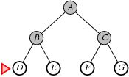
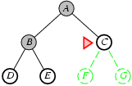
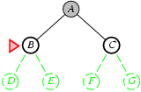
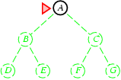
Breadth-first search
Expand shallowest unexpanded node
Implementation:

Slide 9
Breadth-first search
A breadth-first search (BFS) explores nodes nearest the root before exploring nodes further away
For example, after searching A, then B, then C, the search proceeds with D, E, F, G
Node are explored in the order A B C D E F G H I J K L M N O P Q
J will be found before N
A
B
C
D
E
F
G
H
I
J
K
L
M
N
O
P
Q

Slide 10
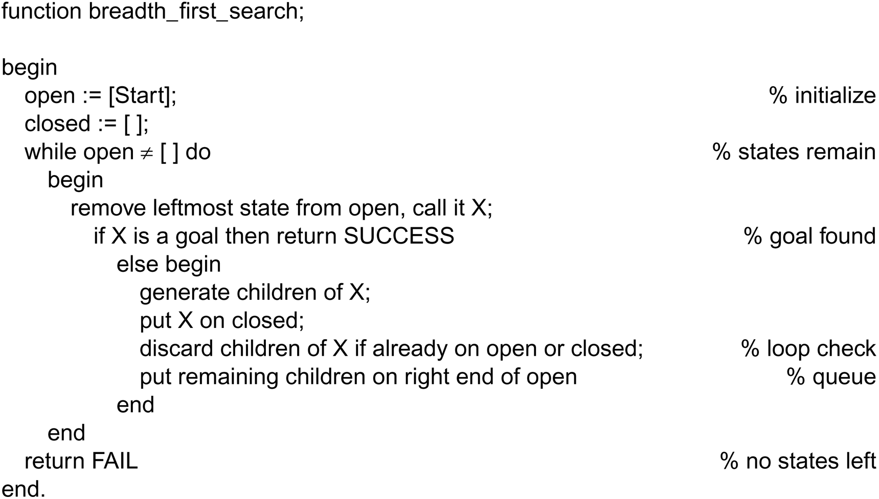
Breadth-first search Algorithm
Nodes are lining up to be visited in open. closed keeps track of all the nodes visited already.

Slide 11
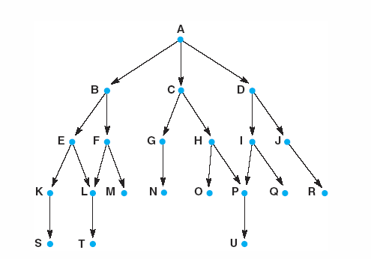
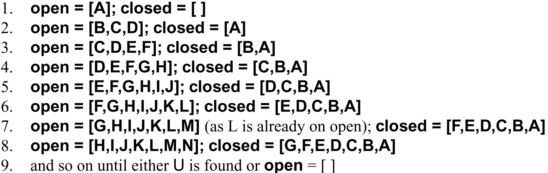
A trace of Breadth-first algorithm
B is not the goal. Put his children onto the queue. Put him in closed. He is done.
|
|
|
Items between red bars are siblings.
|
|
|
|
|
|
|
|
|
|
|
|
goal is reached or open is empty.

Slide 12
Breadth-first search tree
Branching factor: number of nodes generated by a node parent (we called here “b”)
➔ Here after b=2
0 expansion
1 expansion
2 expansions
3 expansions

Slide 13
Depth-first search
Explore only one branch deeper till the solution is found or there is no new state to explore and then start searching the adjacent level.
If the solution exists in the first branch, then depth first search can find the solution quickly.
If the solution exists in some other branches farther away, there won't be much difference between depth first search and breadth first search.

Slide 14
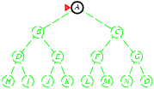
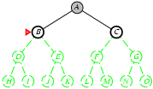
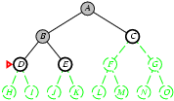
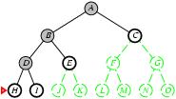
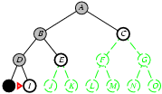
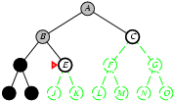
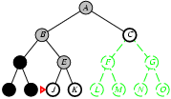
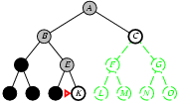
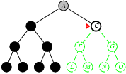
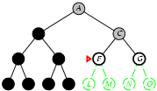
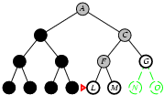
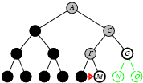
Depth-first search
Expand deepest unexpanded node
Implementation:

Slide 15
Depth-first search
A depth-first search (DFS) explores a path all the way to a leaf before backtracking and exploring another path
For example, after searching A, then B, then D, the search backtracks and tries another path from B
Node are explored in the order A B D E H L M N I O P C F G J K Q
N will be found before J
A
B
C
D
E
F
G
H
I
J
K
L
M
N
O
P
Q

Slide 16
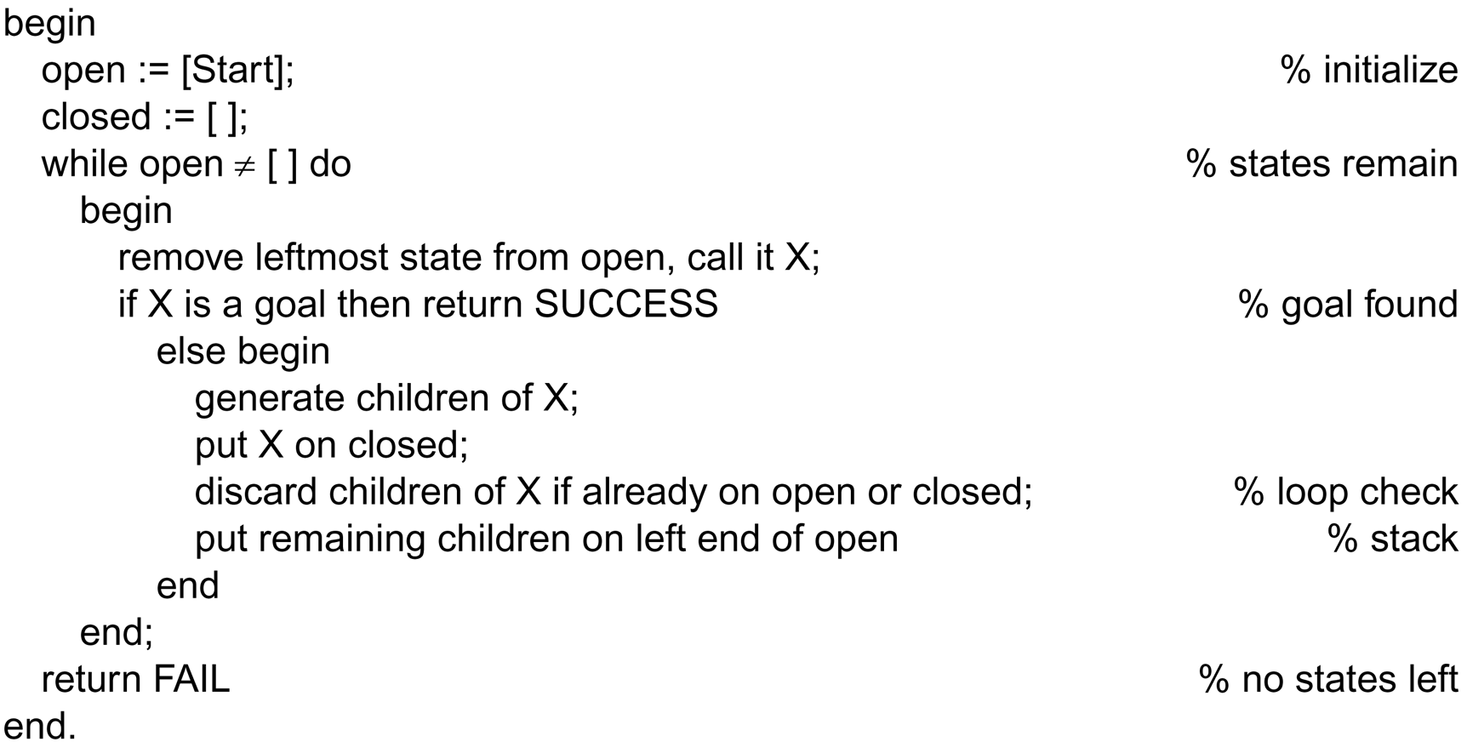
The depth-first search algorithm
This is the only difference between
depth-first and breadth-first.

Slide 17
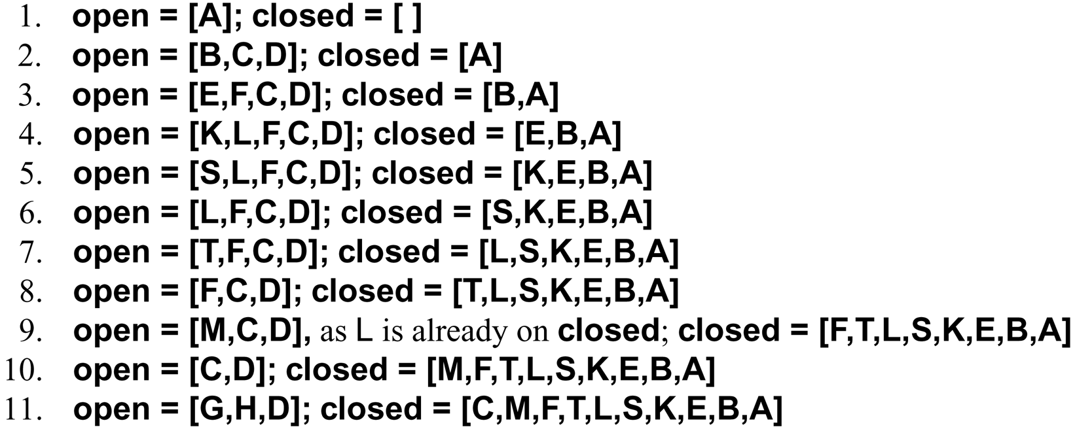
A trace of Depth-first
algorithm
top of stack

Slide 18
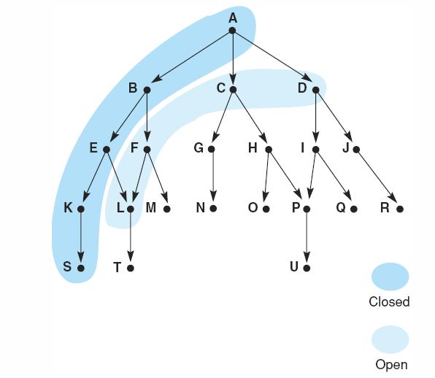
A trace of Depth-first
algorithm
frontier
visited
Snapshot at iteration 6

Slide 19
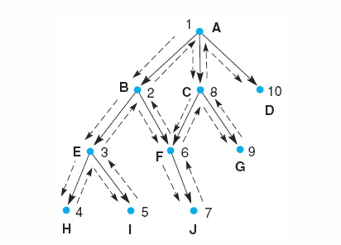
Search sequence of depth-first and breadth-first
Breadth first: A, B, C, …
Depth first: 1, 2, 3, …
Notes:
Insert fig 3.15

Slide 20
Comparing the ordering of search sequences
Determine the order of nodes (states) to be examined
Breadth-first Search
When a state is examined, all its children are examined, one after another.
Explore the search space in a level-by-level fashion.
Depth-first search
When a state is examined, all its children and their descendants are examined before any of its siblings.
Go deeper into the search space where possible.

Slide 21
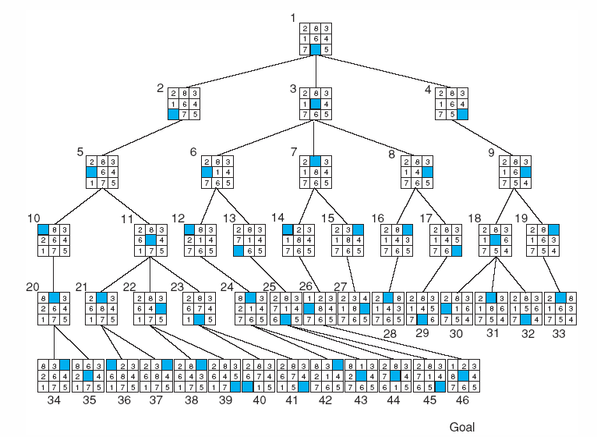
Application of breadth-first on 8-puzzle game
←
↑
→
↓
Cannot move
blank downward
↑
Notes:
For larger versions of the n-puzzle, finding a solution is easy, but the problem of finding the shortest solution is NP-hard

Slide 22
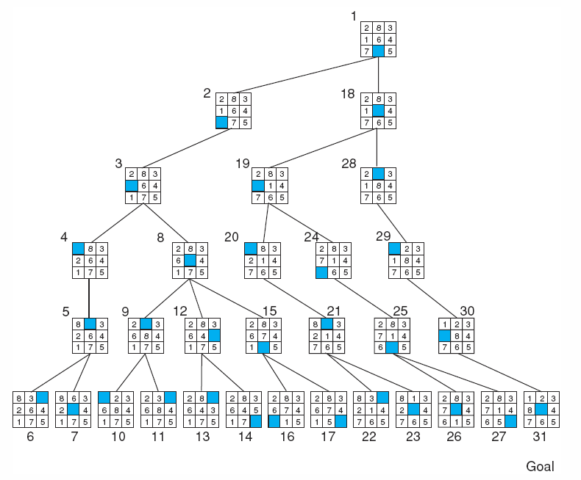
Application of depth-first on 8-puzzle (depth bound 5)
Breadth-first
took
46 nodes.

Slide 23
Thank You

